Slide 1



Microservices Prerequisites Microservices Maturity Model and Assessment Framework Audience: All Roles

Slide 2
Agenda
Microservices Prerequisites
Microservices – History, Driving Forces, and Definition
Microservices Patterns
DevOps
Reactive Microservices
1
5
9
13
AD
All
D
AD
A
Microservices Prerequisites
Integration
Securing Microservices
Testing
2
6
10
14
AD
AD
A
D
A
A
Spring Boot
Migrating Monoliths to Microservices
Domain Driven Design Testing
Scaling Microservices
3
7
11
15
AD
D
A
A
A
Case Study
Cloud
UI
Microservices Anti-Patterns
4
8
12
16
AD
AD
All
All
A
A
Legend: All Developer Advanced Developer Architect
All
D
AD
A

Slide 3

Objectives
Microservices Prerequisites
At the end of this module, you should be able to:
Recognize the challenges faced by clients as they adopt Microservices.
Understand the need for Maturity Assessment.
Understand the Maturity Model and how it affects the aspects of Microservices.
Understand the steps for conducting an assessment, results, and summary.

Slide 4
Topic
Microservices Prerequisites
Microservices Prerequistes
Definition Microservices Complexities faced by clients | Microservices Spectrum and need for Maturity Assessment
Maturity Model
Model Description Aspects of Microservices Conducting an Assessment | Assessment Results Assessment Summary

Slide 5
Microservices Prerequisites

Slide 6
Executive Summary
Microservices Prerequisites
NOTE
The meaning of “maturity” in the context of this tool is not to judge the quality of implementation negatively, but to arrive at the “requirements” and “fit-for-purpose” level of implementation.
Semantic Diffusion
Microservices, over the past few years has assumed many meanings. Depending on who is talking about it, the understanding of Microservices varies
Assessment
Client’s need consulting on relevance of Microservices
The model is based on 20+ Microservices aspects to measure relevance
Relevance
Assessment provided Microservice affinity for a client.
The affinity is associated at a certain maturity.
Maturity
Maturity defines list of:
Capabilities
Values
Costs
Pitfalls
Post Assessment
Provides scoring matrix on aspects to compile the backlog and risk log based on assessed and desired maturity

Slide 7
Microservices Complexities: Faced by Clients
Microservices Prerequisites
Management Complexity
Automation
Consistency
There is an exponential number of components to manage, monitor and maintain.
It is not humanly possible to manage the application that is composed of µS. There must be upfront investment on automation across all phases like build, test, provision, scale, and deploy.
CAP theorem shines brilliantly in the µS world. So, the consistency guarantees that applications should work towards are eventual. This also has impact on everything from service design, transactions, to UI, to UX, monitoring, logging, and everything else.
Infrastructure
Given that Microservices (µS) are disposable and should be brought up on demand, the underlying infrastructure cannot be traditional BareMetal (at least to leverage the full power of µS).
Failures
Applications should assume failures as part of service lifecycle and prepare to deal with failures. This has impact on everything from service design, to UI, to UX, monitoring, logging, and everything else.
Team culture
With reference to Conway’s law – the µS teams needs to be small to mirror the eventual software that they would produce. Also, refer to inverse Conway’s law.
DevOps
Data
If there is no culture within an organisation to automate the build, release, and test processes, then building an application via µS which address single concerns of an application and thus need independent deployments, doesn’t leverage µS. If µS does not increase the velocity of change, then what is the point! DevOps is technology, culture, and reorganization investment.
Modularizing data model on small distributed Microservices is the hard part to get right and often has organization-wide impact.

Slide 8
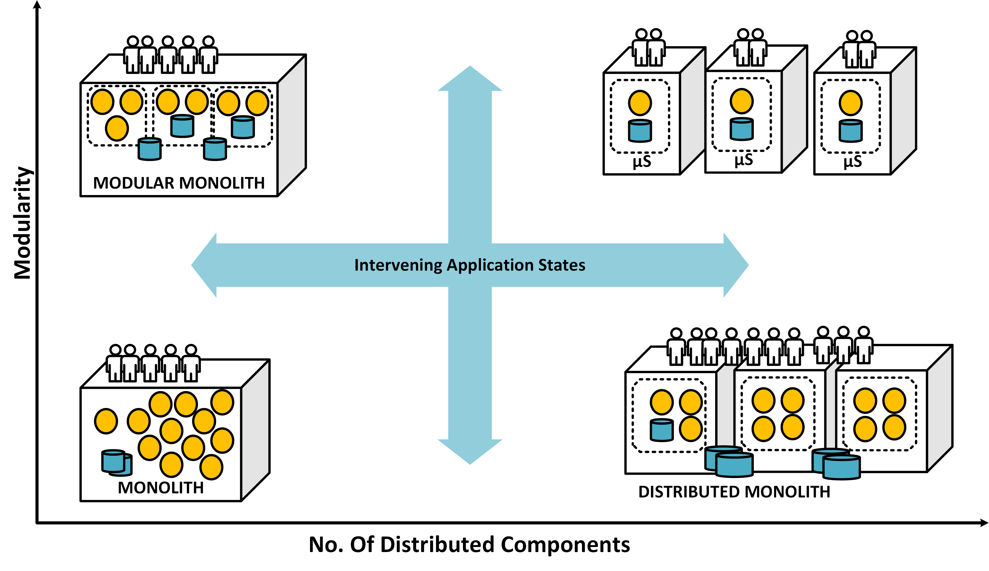
Microservices Spectrum and Need for Maturity Assessment
Microservices Prerequisites
Need for Maturity Levels
Not everyone can be/want to be a Microservices greenfield
Not everyone needs to start with a goal to build highly optimized, domain-driven, absolutely Cloud based, team-culture-refined µS. The focus of engineering should be to delivery value to the client in the time expected by adopting µS architecture that is evolutionary. Such goals should not be non-negotiable from the start. Microservices is a journey paved with trade-offs and balancing acts. (Evolutionary)
Pragmatic Architecture
The varying nature of applications, problems, domains, do not necessitate a unique/one sized architecture for all projects. Good architecture can pick and choose what is needed (being pragmatic) and still be qualified to be called a µS architecture.

Slide 9
Maturity Model

Slide 10
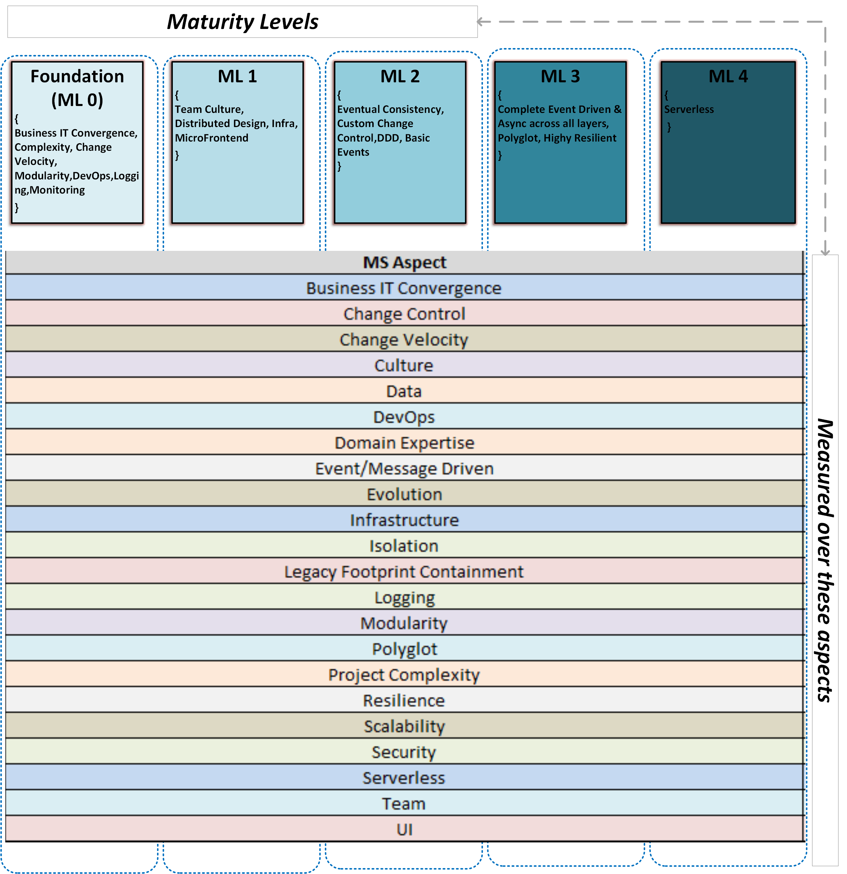
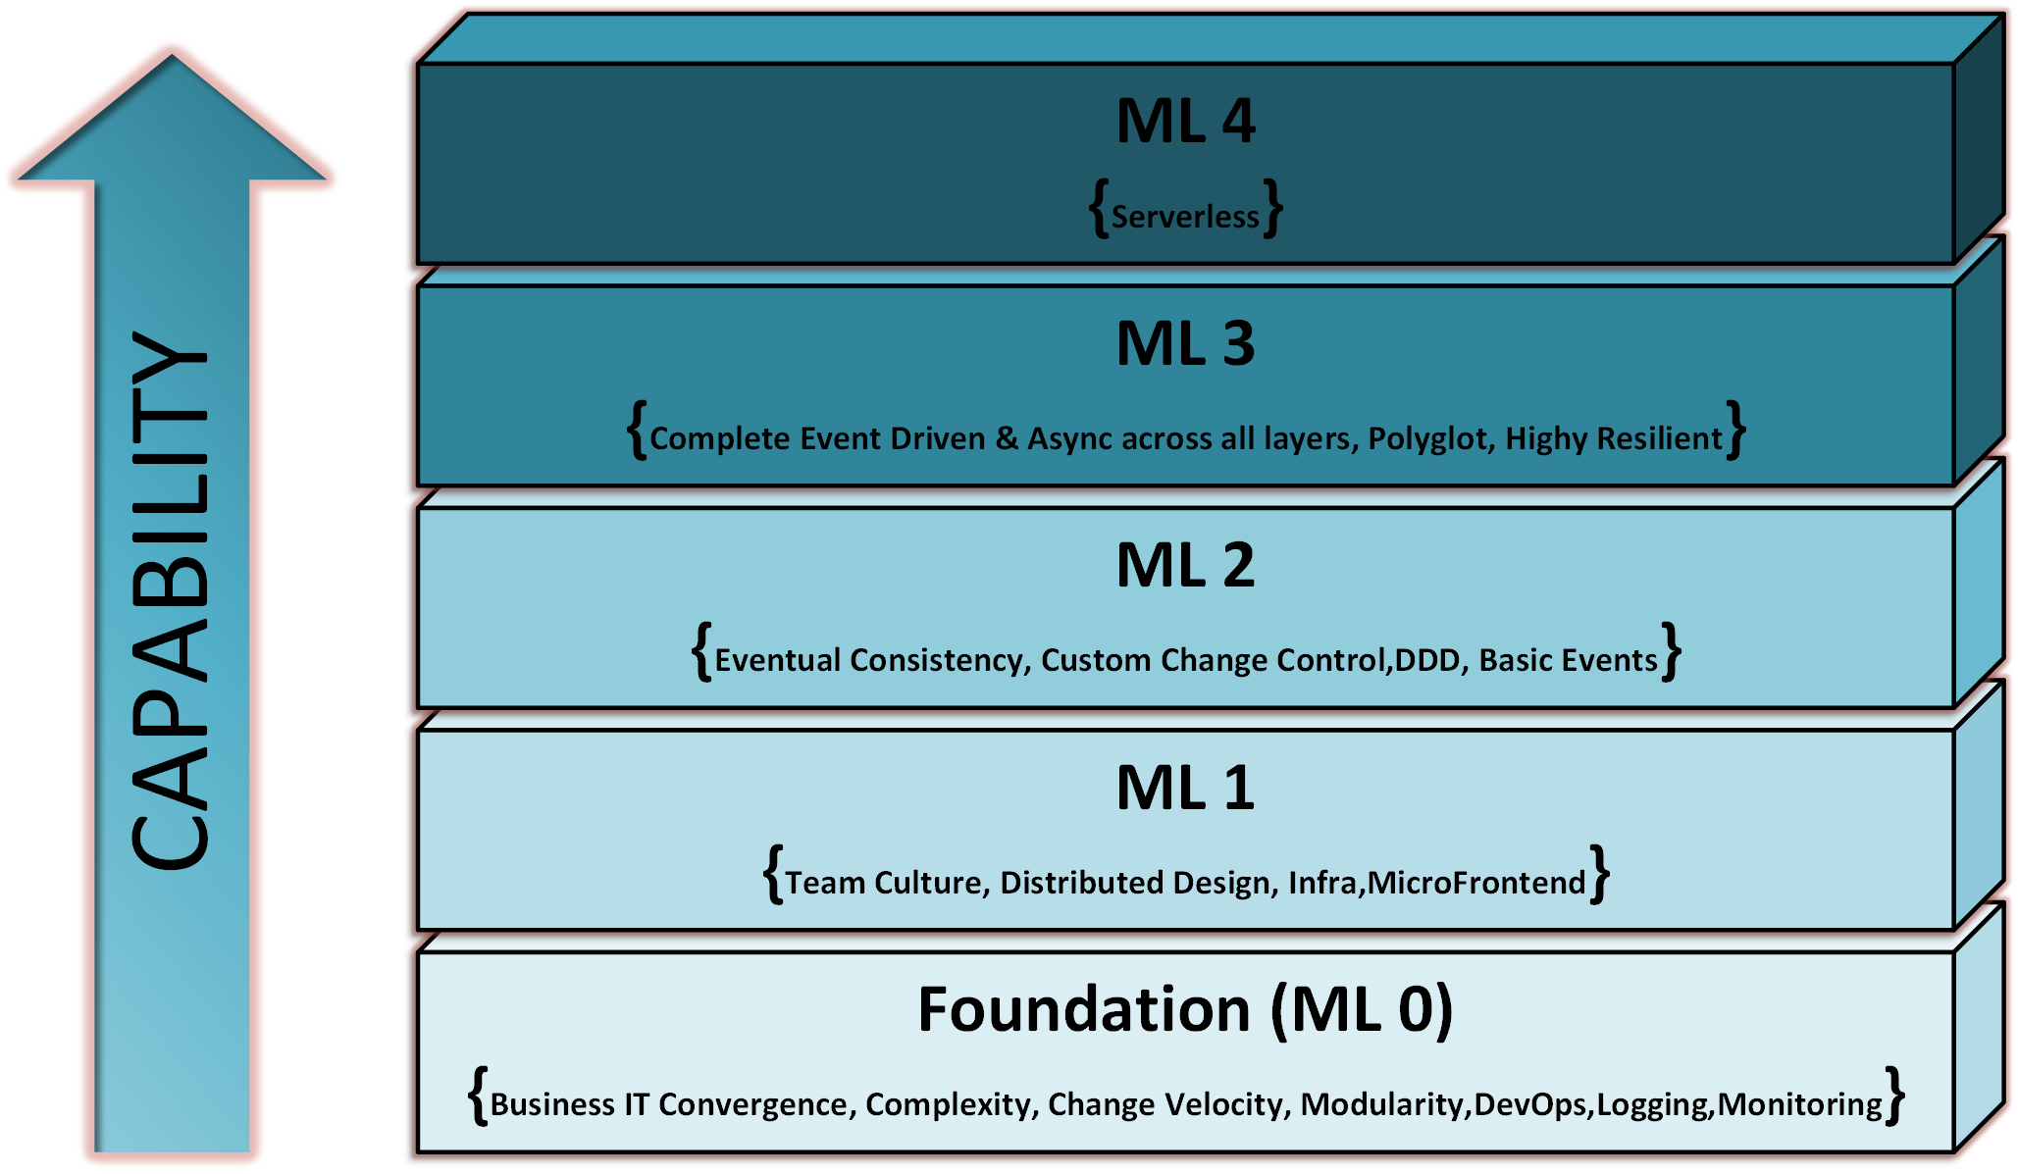
Maturity Model
Maturity Model

Slide 11
Aspects of Microservices
Maturity Model
Aspect | Scoring On
Business IT Convergence | Approvals and Sponsorship Business understanding on transformation
Change Velocity | Pace of change Change Volumes
Change Control | Canary Rollouts Blue/Green A/B
Isolation | Isolation of State Isolation of Space Isolation of Time Isolation of Failure
Culture | Cross-functional Teams Decentralize Governance Agile
Data | Data Models Data Processing CQRS
DevOps | Continuous Integration Continuous Deployment Continuous Testing Continuous Delivery Continuous Monitoring Continuous Chaos
Domain Expertise | Domain Driven Design Domain Events
Event Driven | Async Communication Event Sourcing Compensating Transactions Event Carried State Transfer
Evolution | Evolutionary Architecture Sacrificial Architecture ROI
Aspect | Scoring On
Infrastructure | Cloud Provisioning Environment Availability
Legacy Footprint Containment | Domain in Legacy Systems Microservices as only Integration Layer
Logging | Event Logs Infrastructure Logs
Modularity | Monetizing Modules Slicing Layers
Polyglot | Programming Languages Polyglot Persistence
Project Complexity | Complexity of Change
Resilience | Failure Isolation Failure Detection HA Retry and Healing
Scalability | Isolated Scaling Autoscaling
Serverless | Cloud Functions Stateless Services
Security | Defence in Depth ACL Data Security Cloud Native Security
Team | Team Readiness
UI | MicroFrontEnds BFF Reactive UI Consumer Driven Queries

Slide 12
Conducting an Assessment
Maturity Model
Approach
The responses provided should be based on “best known facts” at the time of assessment, “at the right scale”, so that the assessment of reflective pragmatic affinity instead of an ambitious state that the project may want to be.
Scheduling
The most minimalistic assessment has run into 3 hours, so that should be taken as a baseline while scheduling. The maximum time to complete assessment is based on the discussions and actions that come out of assessment workshop.
Interpretation
Should be iterative
Participant Roles
Post Assessment
Solution Architecture
Triggers discussion
Identify risks and cost of assessment at the derived maturity level
Should result into a backlog of changes
Business/Domain expert
Data Architect
UI/UX Architect
DevOps Architect
Project Manager
Walk the client teams through assessment report.
Cost, Indicators, Pitfalls and values are described in model for all values.
Prepare the actions, risks, backlog for the project team

Slide 13
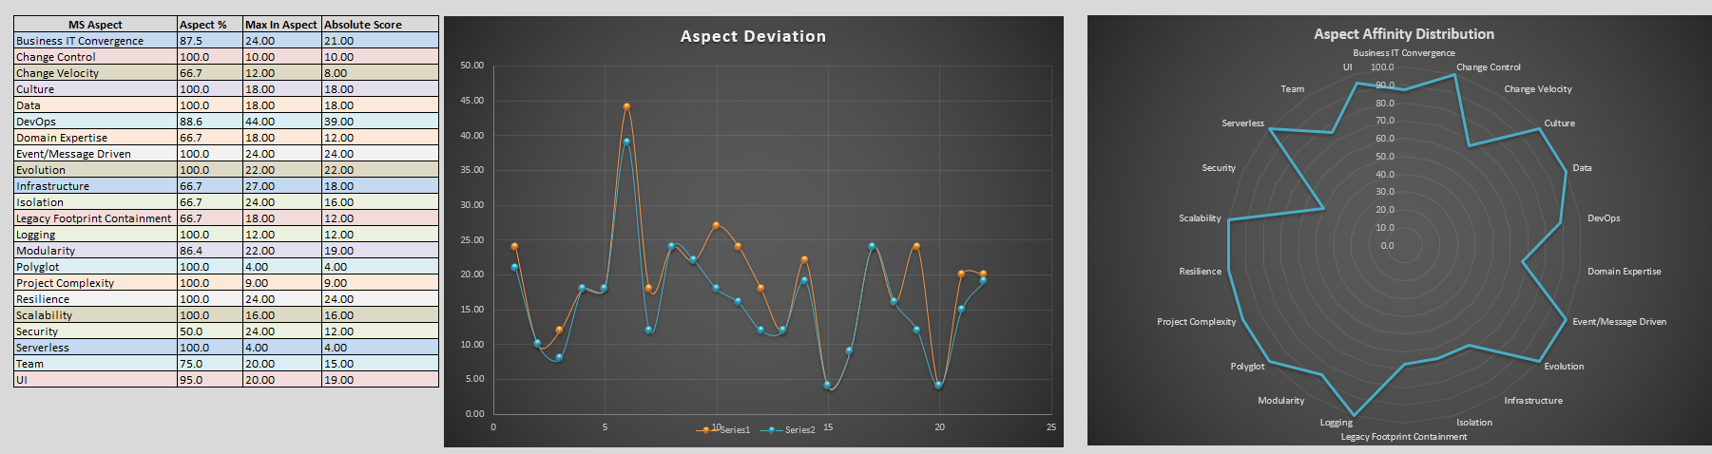
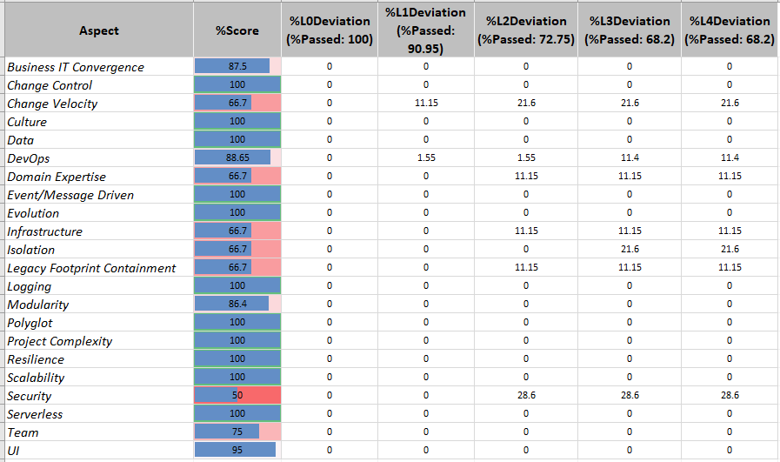
Assessment Results
Maturity Model

Slide 14
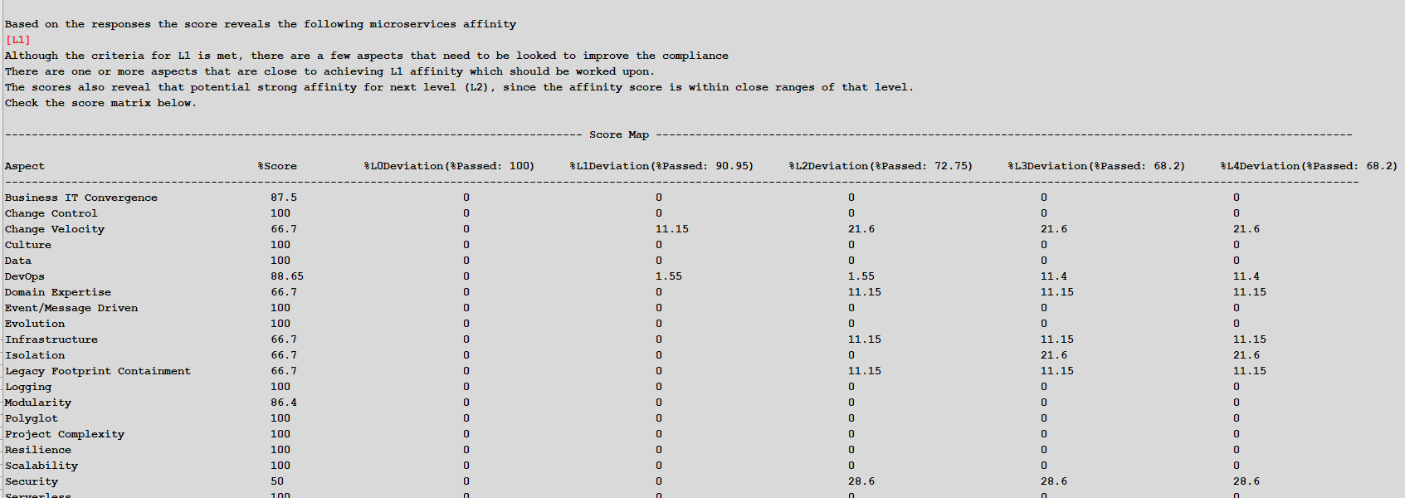
Assessment Summary
Maturity Model

Slide 15

Q&A

Slide 16

Summary
Microservices Prerequisites
Summary
You have completed the Microservices Prerequisites module. You should now be able to:
Recognize the challenges faced by clients as they adopt Microservices.
Understand the need for Maturity Assessment.
Understand the Maturity Model and how it affects the aspects of Microservices.
Understand the steps for conducting an assessment, results, and summary.

